Slide 1
Risultati di uno studio monocentrico su 94 procedure di endosleeve
Lino polese
Centro di chirurgia bariatrica – universita’ di padova (Dir. M. foletto)

Slide 2
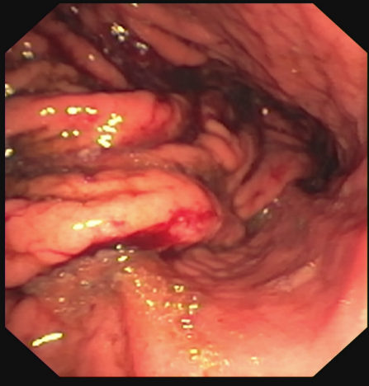
Endoscopic Sleeve Gastroplasty
Minimally invasive treatment for Obesity
First proposed in 2009
With extablished efficacy and safety
Still to know what long-term results are
and which patients can benefit most

Slide 3

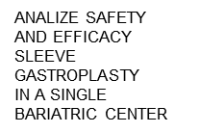
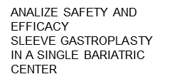
Aim of the study
ANALIZE SAFETY AND EFFICACY
SLEEVE GASTROPLASTY
IN A SINGLE BARIATRIC CENTER
ANALIZE SAFETY AND EFFICACY
SLEEVE GASTROPLASTY
IN A SINGLE BARIATRIC CENTER
ANALIZE SAFETY AND EFFICACY
SLEEVE GASTROPLASTY
IN A SINGLE BARIATRIC CENTER
Analyze safety and efficacy
sleeve gastroplasty
In a SINGLE bariatric CENTER
ANALIZE SAFETY AND EFFICACY
SLEEVE GASTROPLASTY
IN A SINGLE BARIATRIC CENTER
ANALIZE SAFETY AND EFFICACY
SLEEVE GASTROPLASTY
IN A SINGLE BARIATRIC CENTER
ANALIZE SAFETY AND EFFICACY
SLEEVE GASTROPLASTY
IN A SINGLE BARIATRIC CENTER
ANALIZE SAFETY AND EFFICACY
SLEEVE GASTROPLASTY
IN A SINGLE BARIATRIC CENTER

Slide 4
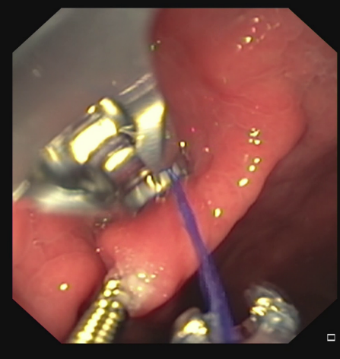
Methods
Indications:
BMI <40kg/m² without complications
High risk for surgery
Technique:
Gastric tubularization on the greater curvature
Suture transverse monolinear in multiple bites

Slide 5
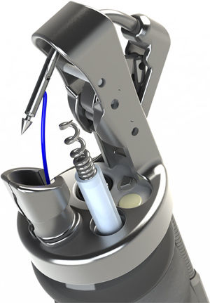
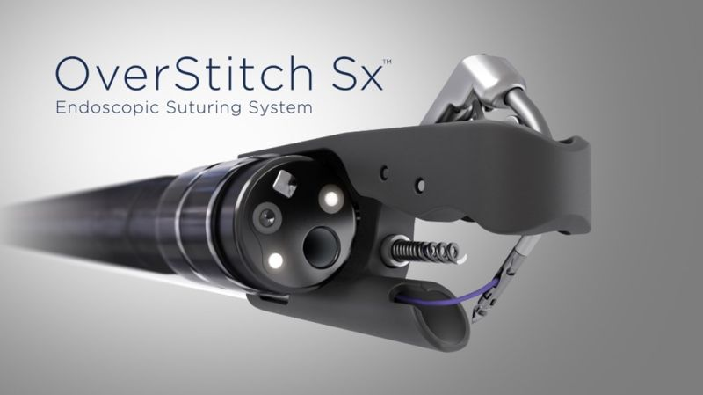
Methods
Suturing system :
Apollo Overstitch + double channel gastroscope
Apollo Overstitch Sx + standard gastroscope

Slide 6
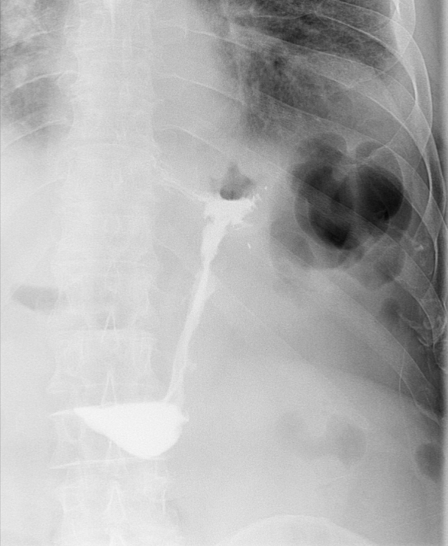
Methods
- Water-soluble swallow test on post-operative day 1
- Soft diet
- Follow up visits at 1 month, then every 6 months
- During visits patients are weighed
- Results are presented as TBWL and %EWL

Slide 7
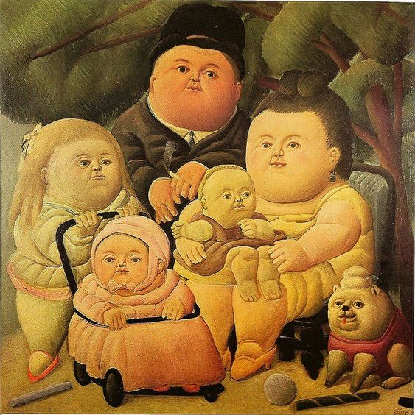
Results: treated patients
(Jan 2019-August 2025)
Bariatric Surgery, Padova University-Hospital, Italy
94 procedures
89 patients (F/M)
40 BMI<40 Kg/m² without complications
49 not suitable for surgery
Mean age 53 ys (range 21-75ys)
BMI (mean ± SD) 37±5 Kg/mq

Slide 8
Total complications: 4/94 (4.2%)
3 bleedings (3.2%)
- 2 pts were receiving anticoagulant, 1 pt anti-platelet
- all self-limiting (in one diagnostic OGD, in one blood transfusions)
1 impaired gastric emptying (1%)
- in a case of repeated endosleeve
- treated by endosleeve reversal with improvement
Result: Complications

Slide 9
Results
Time follow-up | 1 month | 6 months | 12 months | 18 months | 24 months
%TBWL | 9.4±5.2 | 12.8±7.7 | 11.6±8.8 | 10.7±9.8 | 10.4±12.2
%EWL | 32±19 | 41±25 | 43±43 | 41±50 | 37±48

Slide 10
Results: predictive factors
Better results (%EWL)
BMI<35 vs BMI>35 % EWL 58 vs 34 at 1 year (p<0.05)
Female vs Male % EWL 49 vs 23 at 1 year (p<0.05)
- Sleeve length>1/3 stomach length (p<0.05)

Slide 11
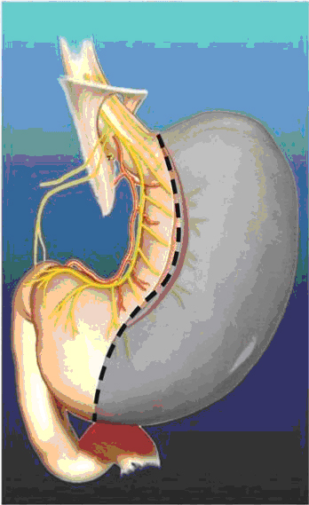
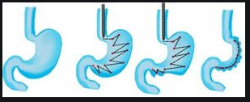
Results
After failure
5 patients → sleeve gastrectomy
5 patients → re-endosleeve
1 patient → mini-bypass

Slide 12
Conclusions
Endo-sleeve is a safe procedure
More effective for BMI <35
Better results in female patients
Maximum weight loss (43%EWL) is reached at approximately 1 year and remains quite stable afterwards

Slide 13
Thank you!
Lino Polese, Luca Prevedello, Alice Albanese, Giulia Pozza,
Sabrina Rampado, Mirto Foletto
UOSD Chirurgia Bariatrica
Azienda Ospedale-Università, Padova
Case Manager
Daniela Casarotto

